Slide 1

Texas State University
LibQUAL Survey 2015
Core Survey Section IC 1-8
Information Control
Ray Uzwyshyn
Director, Collections and Digital Services
Texas State University Library

Slide 2


Information Control on LibQUAL is One of Three Core Item Survey Sections
LibQUAL Lite Survey: 22 Questions
1) AS-1-9: Affect of Service (9)
2) IC-1-8: Information Control
(8 Questions)
3) LP-1-5: Library as Place (5)

Slide 3

Information Control IC 1-4
(Perceptions of Service Quality)
IC-1 Does the library make electronic resources accessible from my office?
IC-2 Does the library Web site enable me to locate information on my own?
IC-3 Does the library contain printed materials I need for my work?
IC-4 Does the library contain the electronic information resources I need?
IC 1-4 range from electronic
resources to
remote access, the website and the print library
Notes:
Information Control Section of the Survey surrounds perceptions of service quality regarding information control. As you can see immediately it ranges from print to electronic resources and questions relating to remote access, the website and the print library.

Slide 4

Information Control IC 5-8
IC-5 Does the library possess the modern equipment that lets me easily access needed information?
IC-6 Does the library possess the easy-to-use access tools that allow me to find things on my own?
IC-7 Does the library make information easily accessible for independent use?
IC-8 Does the library possess the electronic journal collections I require for my work
Questions also relate to
The library’s modern equipment,
(hardware), online tools, access
And electronic journal articles
Notes:
Many questions relate also to information access, hardware (the modern equipment) and more specific questions (e-journals/print books). Somewhat of a mish mash that goes beyond info control to content but that is Libqual.

Slide 5



LibQUAL Goals
Help Libraries Better Understand ‘perceptions of library Service Quality
Collect and Interpret library user feedback systematically over time
Notes:
Those perceptions as outlined may not be the ones we perceive. This allows us to collect, interpret and act upon library user feeddback systematically over time.

Slide 6

Information Control Summary Results
(2, 142 Respondents)
Scale From a low of 1 to high of 9, no 10’s
Minimum Mean = My Minimum Service Level
Desired Mean = My Desired Service Level Perceived Mean = My ‘Perceived’ Service Performance Level
IC-2 = Library Website has both
highest minimum service level and
highest desired service level
Notes:
Highest level of expectation for the library website from all survey respondents. This includes, faculty, students, staff and library staff.

Slide 7


LibQUAL Lite 2013-2015 Comparison
INFORMATION CONTROL |  | Perceived Mean 2013 | Perceived Mean 2015
IC-1 | Making electronic resources accessible from my home or office | 7.34 | 7.42
IC-2 | A library Web site enabling me to locate information on my own | 7.33 | 7.36
IC-3 | The printed library materials I need for my work | 7.24 | 7.43
IC-4 | The electronic information resources I need | 7.15 | 7.21
IC-5 | Modern equipment that lets me easily access needed information | 7.49 | 7.60
IC-6 | Easy-to-use access tools that allow me to find things on my own | 7.17 | 7.27
IC-7 | Making information easily accessible for independent use | 7.48 | 7.39
IC-8 | Print and/or electronic journal collections I require for my work | 7.17 | 7.37
y
Notes:
We are not going back farther because Libqual lite is qualitiative different from the previous longer survey (comparing apples with oranges)For information control, the library Went up in All categories for our perceived level of service with the exception of IC-7 (Making information easily accessible for independent use).

Slide 8
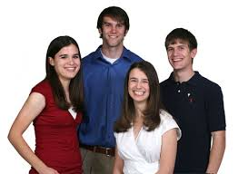
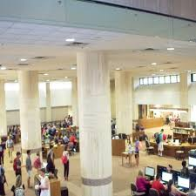
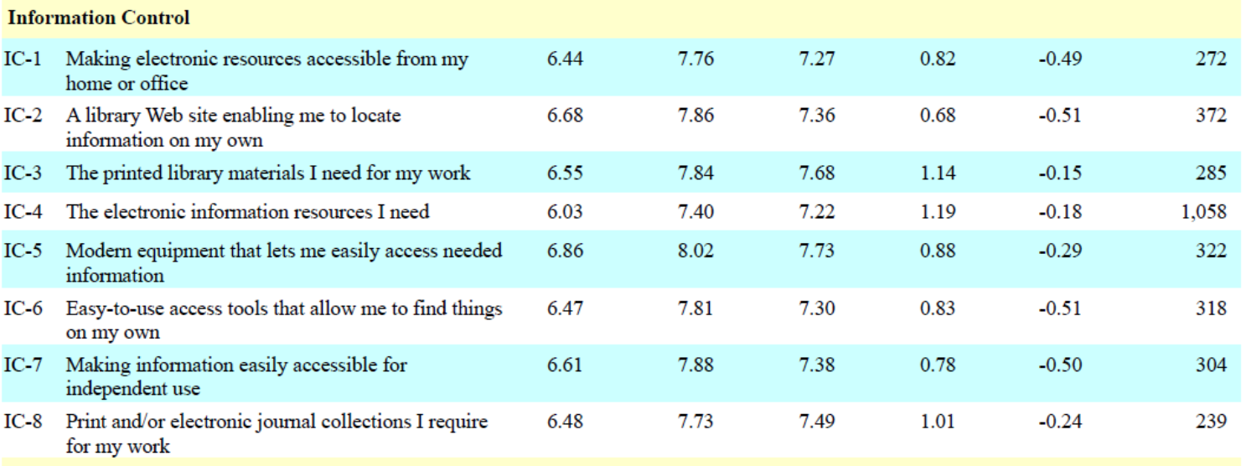
Undergraduate Summary
(1,087 Respondents)
Undergraduates perceive equipment (computers, internet access, other hardware possibilities
as high priorities). Highest minimum, highest desired, highest perceived.
Notes:
What is meant by ‘modern equipment’ (PC’s, laptops, mobile devices, internet enabled whiteboards etc.). Is this signifying a shift towards technology rich learning commons ideas for undergraduate populace.

Slide 9


Graduate Summary
(522 Respondents)
Note for
Later
Highest
Low
Adequacy Mean = Perceived Mean – Minimum Mean. Negative number suggests we are
performing below a minimum standard.
Superiority Mean = Perceived Mean – Desired Mean.
Notes:
Graduates Perceive electronic resource access from home or office as the highest priority For graduates also the website is not up to their standards as the Adequacy mean is below their minimum expectation. Adequeacy Mean = Perceptions of what we currently possess – minimum level of expectation. Note the Superiority mean for later.

Slide 10
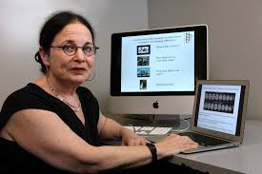
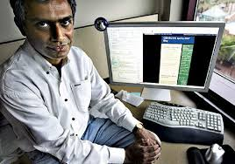

Faculty Summary
(237 Respondents)
Note for
Later
Highest
Adequacy mean = Perceived – Minimum. How much better than faculty’s lowest standards.
Negative number = performing below faculty’s minimum expectation.
Notes:
Making electronic resources accessible from my home or office computer is also highest priority for faculty (Similar to Graduate students). Also, similar to the graduate students, the website enabling faculty members to locate information on their own is not up to standards for faculty. Adequacy mean is below zero which again means that the adequacy mean is below their minimum expectations. Note again here that the superiority mean is similarly in the negative.

Slide 11
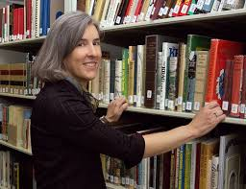

Library Staff Summary
(25 Respondents)
Note Staff
Faculty/Grad.
Disparity
Differing Faculty/Grad
Staff Opinions
Faculty SM = - 0.81
Grad. SM = -0.87
Difference in
Perception = 1.33
Highest Minimum and Desired Expectations
For Staff still revolve around Print!
Notes:
Here, I wish to turn to again, making electronic resources accessible from my home or office. Note that the superiority mean is on a different side of the scale from both previous negative Faculty or Graduate expectations. This means the staff feel we are knocking this one out of the park >0 with zero being faculty desire. While the faculty and graduate students feel we are doing much less than desired. More than a point spread between perceptions which is interesting. Also, surprisingly most important staff priorities are very print focused. Highest minimum and desired expectations revolve around print books. To also note here, the response rate from staff on these questions are not high.

Slide 12
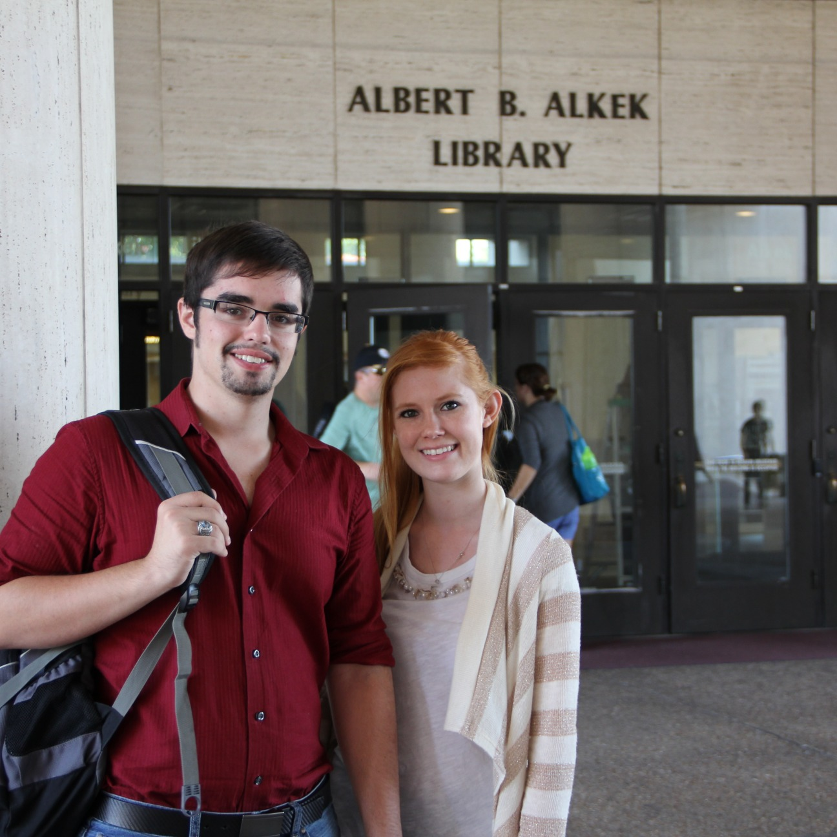
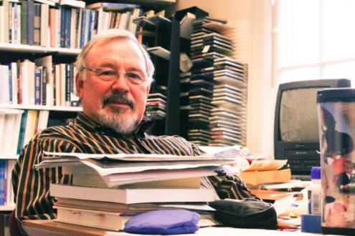
Comments Section
Many Many Compliments
My favorite part of the library is the wide selection of print books that are available to students, especially the facsimile copies of old texts that are long out of print
Alkek provides me with many features that help me prepare.

Slide 13
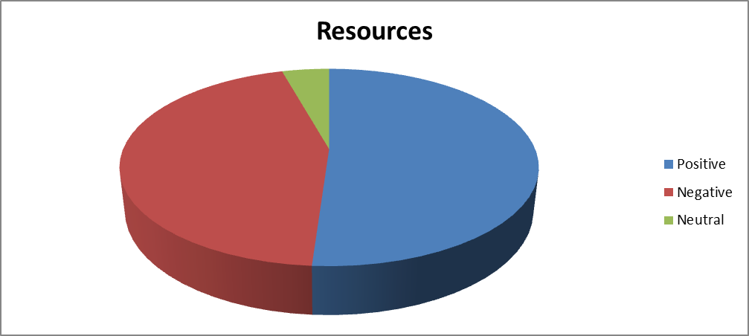

Resources Comments
Notes:
Approximately fifty/fifty positive negative comments on resources for people taking the time to comment. You can

Slide 14

Resources Comments Samples
One year embargo on journals can lead to unacceptable delays in accessing emerging research.
Expansion of the e-book collection is essential.
Notes:
Many Great comments on the library but these samples focus on room for improvement. Food for thought.

Slide 15
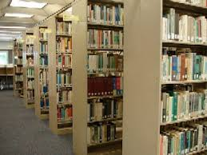

Collections Comments
Worth looking at comments from History, English, Engineering, Performing Arts further.
Notes:
From the charts and disciplinary breakdown of comments, it is possible to look with more granularity at positive/negative comments from collections. From Here, probably worth looking further for subject librarians from Computer Science, English, History, Performing and Fine Arts

Slide 16



Collections Comments
we need to replace basic DVDs that have gone missing
* Please make an effort to maintain physical printed books and journals. I realize that many "forward thinking" librarians are perversely determined to render themselves obsolete by pulping their collections and converting to e-books, digital magazines, and electronic ephemera, but this is a slippery slope toward turning Alkek into a gargantuan student lounge.

Slide 17
Online Tools
(Library Web Applications)
Notes:
Interestingly, more than one negative comment from Business, Social Work, Biology, History, Sociology and even our staff.

Slide 18
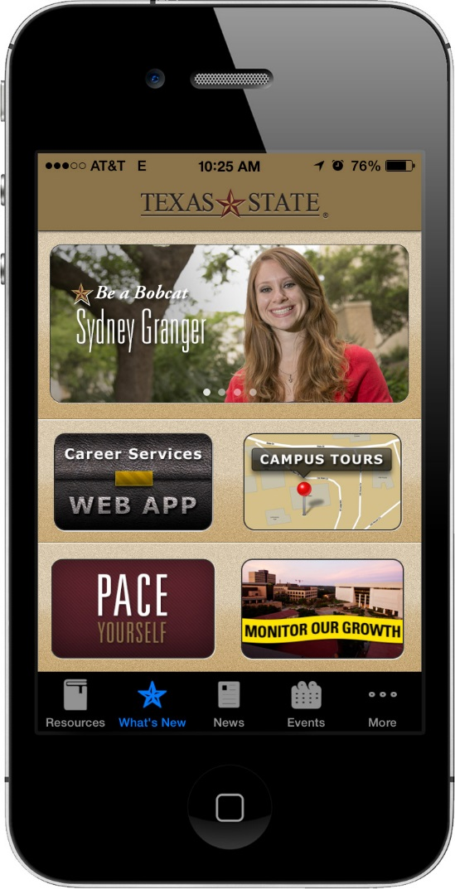
Online Tools Comments
A newsletter about how to best use the library website would be helpful. It could be a monthly letter showing students what tool on the web is useful for finding info within the website.
The website looks like a completely different website when using mobile devices.

Slide 19
Peer Comparison: Information Control
INFORMATION CONTROL |  |  |  |  | Adequacy Mean
IC-1 | Making electronic resources accessible from my home or office |  |  |  | -0.01 | 0.08 | 0.30 | 0.32 | 0.41 | 0.44 | 0.58 | 0.75
IC-2 | A library Web site enabling me to locate information on my own |  |  |  | 0.30 | 0.35 | 0.36 | 0.41 | 0.44 | 0.45 | 0.58 | 0.81
IC-3 | The printed library materials I need for my work |  |  |  | 0.46 | 0.52 | 0.64 | 0.80 | 0.88 | 0.88 | 1.04 | 1.05
IC-4 | The electronic information resources I need |  |  |  | 0.38 | 0.71 | 0.71 | 0.73 | 0.86 | 0.94 | 1.00 | 1.16
IC-5 | Modern equipment that lets me easily access needed information |  |  |  | 0.40 | 0.42 | 0.51 | 0.56 | 0.56 | 0.66 | 0.75 | 0.80
IC-6 | Easy-to-use access tools that allow me to find things on my own |  |  |  | 0.29 | 0.42 | 0.46 | 0.51 | 0.59 | 0.62 | 0.70 | 0.82
IC-7 | Making information easily accessible for independent use |  |  |  | 0.18 | 0.46 | 0.51 | 0.57 | 0.67 | 0.70 | 0.78 | 0.85
IC-8 | Print and/or electronic journal collections I require for my work |  |  |  | 0.02 | 0.41 | 0.44 | 0.47 | 0.59 | 0.65 | 0.69 | 0.80
Low
High
Texas State | Florida State | James Madison | UTD | UTSA | U of Houston | Univ Mass-Amherst | Portland State
Notes:
In terms of perceptions of adequacy, Texas State is in the lower middle range. Adequacy Mean = Perceived Mean – Minimum Mean. Negative number suggests we are
performing below a minimum standard.

Slide 20

Peer Comparison: Information Control
INFORMATION CONTROL |  |  |  |  | Superiority Mean
IC-1 | Making electronic resources accessible from my home or office |  |  |  | -1.40 | -1.08 | -0.85 | -0.80 | -0.74 | -0.74 | -0.68 | -0.59
IC-2 | A library Web site enabling me to locate information on my own |  |  |  | -1.06 | -0.93 | -0.90 | -0.82 | -0.71 | -0.67 | -0.67 | -0.47
IC-3 | The printed library materials I need for my work |  |  |  | -0.99 | -0.64 | -0.54 | -0.50 | -0.48 | -0.48 | -0.44 | -0.25
IC-4 | The electronic information resources I need |  |  |  | -0.79 | -0.73 | -0.71 | -0.62 | -0.54 | -0.47 | -0.45 | -0.35
IC-5 | Modern equipment that lets me easily access needed information |  |  |  | -0.73 | -0.72 | -0.70 | -0.66 | -0.64 | -0.59 | -0.49 | -0.39
IC-6 | Easy-to-use access tools that allow me to find things on my own |  |  |  | -1.15 | -0.93 | -0.84 | -0.73 | -0.70 | -0.68 | -0.67 | -0.45
IC-7 | Making information easily accessible for independent use |  |  |  | -0.96 | -0.78 | -0.70 | -0.69 | -0.61 | -0.57 | -0.51 | -0.41
IC-8 | Print and/or electronic journal collections I require for my work |  |  |  | -0.88 | -0.83 | -0.80 | -0.74 | -0.59 | -0.58 | -0.49 | -0.35
Low
High
Texas State | Florida State | James Madison | UTD | UTSA | U of Houston | Univ Mass-Amherst | Portland State
Notes:
For the Superiority mean, we are squarely in the middle. Again, UT San Antonio is blowing this out of the water with the highest superiority mean over almost all information control categories. Portland State has some work to do. We could be a little higher here. Superiority Mean = Perceived Mean – Desired Mean.

Slide 21
Peer Comparison: Information Control
 | Information Control |  |  | Perceived Mean
IC-1 | Making electronic resources accessible from my home or office |  |  | 6.41 | 7.14 | 7.16 | 7.20 | 7.29 | 7.30 | 7.34 | 7.64
IC-2 | A library Web site enabling me to locate information on my own |  |  | 6.95 | 7.19 | 7.21 | 7.30 | 7.33 | 7.37 | 7.38 | 7.47
IC-3 | The printed library materials I need for my work |  |  | 6.93 | 6.94 | 6.96 | 6.99 | 7.07 | 7.24 | 7.33 | 7.43
IC-4 | The electronic information resources I need |  |  | 6.99 | 7.07 | 7.12 | 7.14 | 7.15 | 7.18 | 7.39 | 7.48
IC-5 | Modern equipment that lets me easily access needed information |  |  | 7.11 | 7.14 | 7.22 | 7.44 | 7.49 | 7.49 | 7.49 | 7.67
IC-6 | Easy-to-use access tools that allow me to find things on my own |  |  | 6.90 | 7.03 | 7.09 | 7.13 | 7.15 | 7.17 | 7.37 | 7.46
IC-7 | Making information easily accessible for independent use |  |  | 7.17 | 7.18 | 7.19 | 7.23 | 7.32 | 7.47 | 7.48 | 7.50
IC-8 | Print and/or electronic journal collections I require for my work |  |  | 7.03 | 7.16 | 7.17 | 7.21 | 7.38 | 7.39 | 7.52 | 7.54
Low
High
Texas State | Florida State | James Madison | UTD | UTSA | U of Houston | Univ Mass-Amherst | Portland State
Notes:
Texas State is right around the middle going towards high in terms of user perception of services in comparison with our peers. To note also, University of Texas San Antonio is at the top of user perceptions while university of Texas, Dallas is at the bottom of user perceptions.

Slide 22
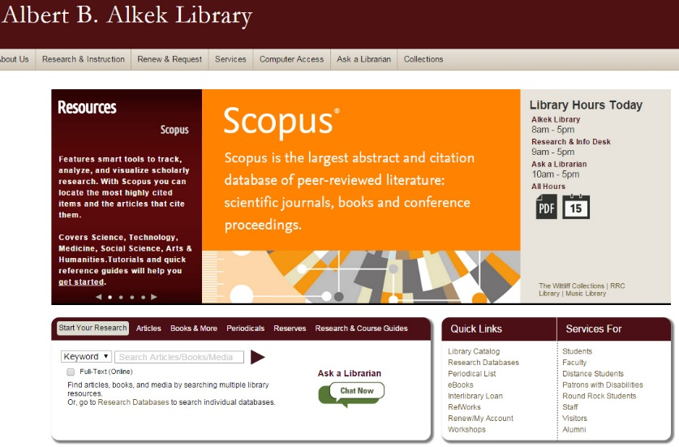
Information Control Libqual Areas
To Explore Further
Website/Online Systems, Usability (Faculty, Grad Students), Mobile site, Online Help, Usage Education
Electronic Resources, e-journals, eBooks/print, Disciplinary
Comments in particular
Deeper Dive into Collection Development, Subject Area Acquisitions, Comments Section

Slide 23
Questions/Comments

